Slide 1
Continuous control of an n-link inverted pendulum on a cart
Oleg Rogov

Slide 2
Main idea
Make the n-link (from 1-link to 3-link) system controlled in a continuous fashion achieve comparable performance with discrete control scheme
2

Slide 3
Preview
Results – PPO agents on pendulum systems (3 slides)
Outcomes (1 slide)
Next steps (1 slide)
3

Slide 4
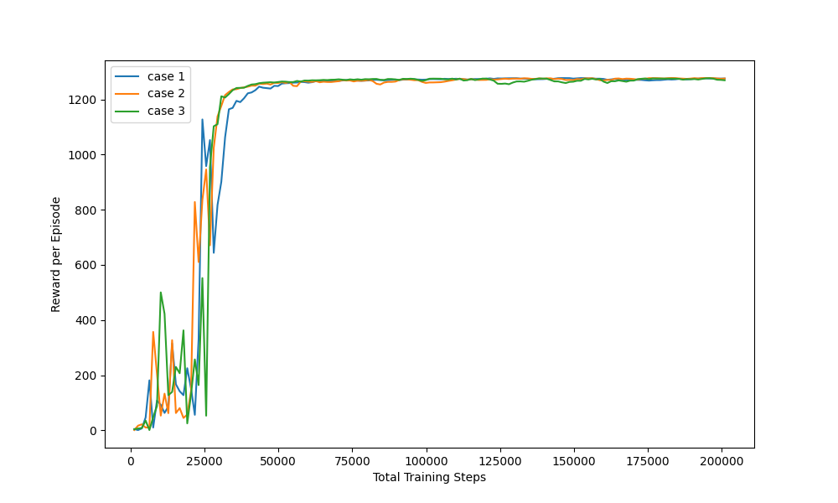
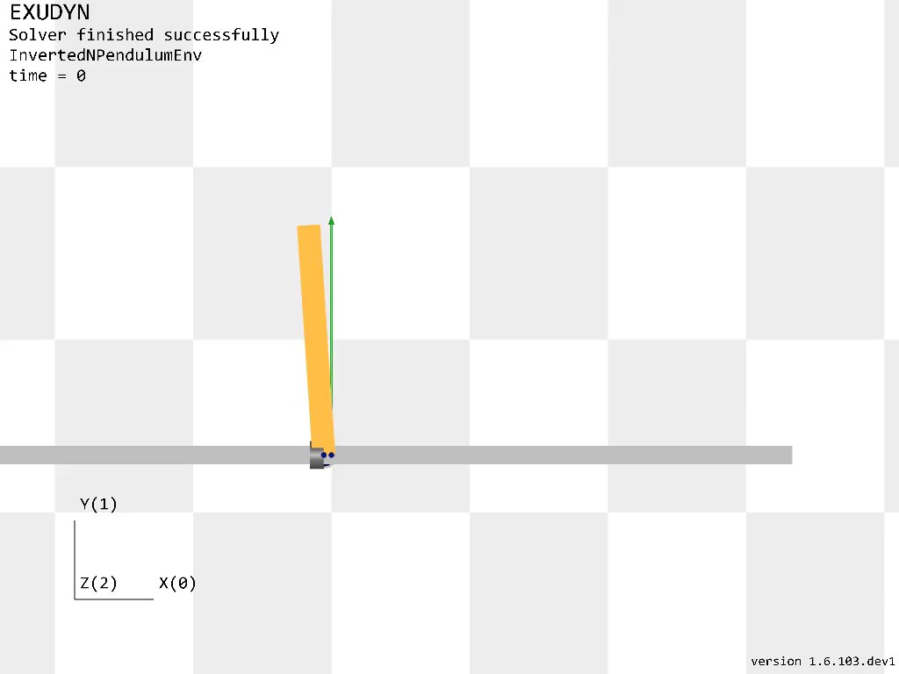
Single Pendulum
PPO
50/50 successful tests on 30-32k timesteps for all 3 cases – fast training of the model (100-200k on PPO for discrete control)
The “smoothness” of the control could easily be seen
4

Slide 5
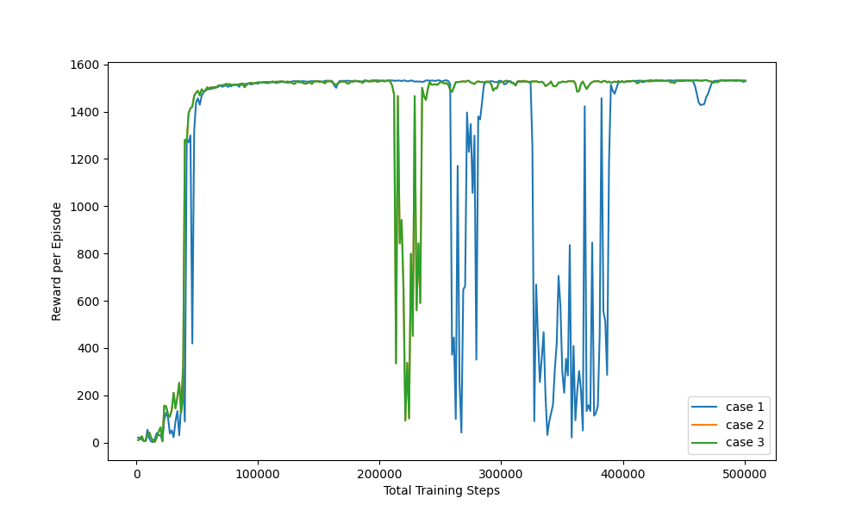
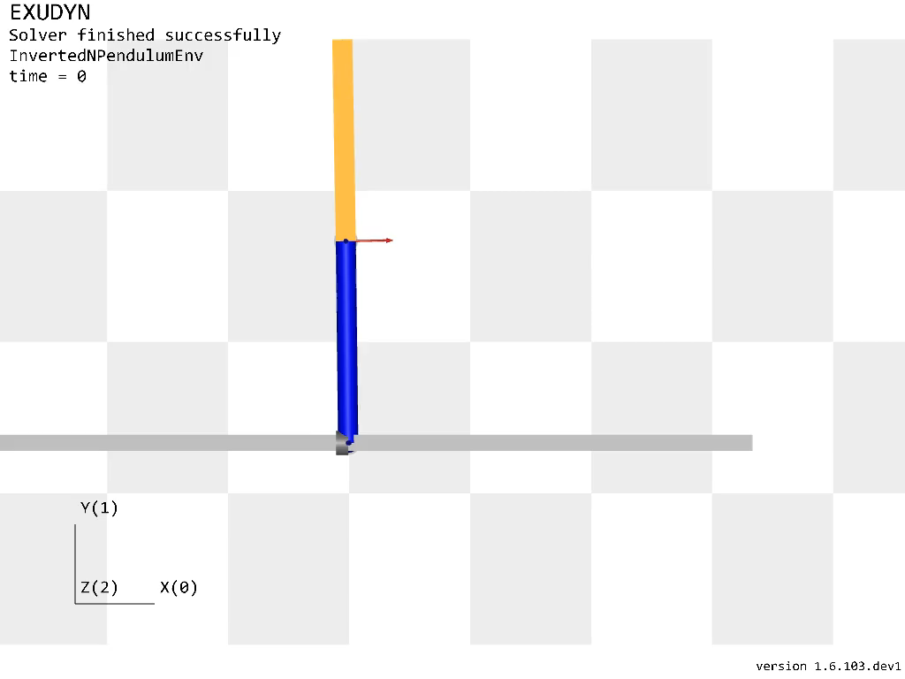
Double Pendulum
PPO
50/50 tests achieved on 46-61k timesteps
(on discrete scheme PPO requires at least around 200k)
5

Slide 6
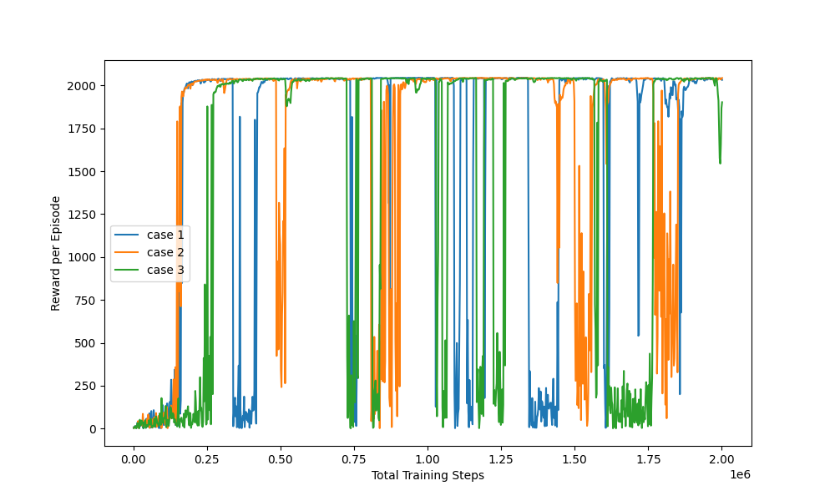
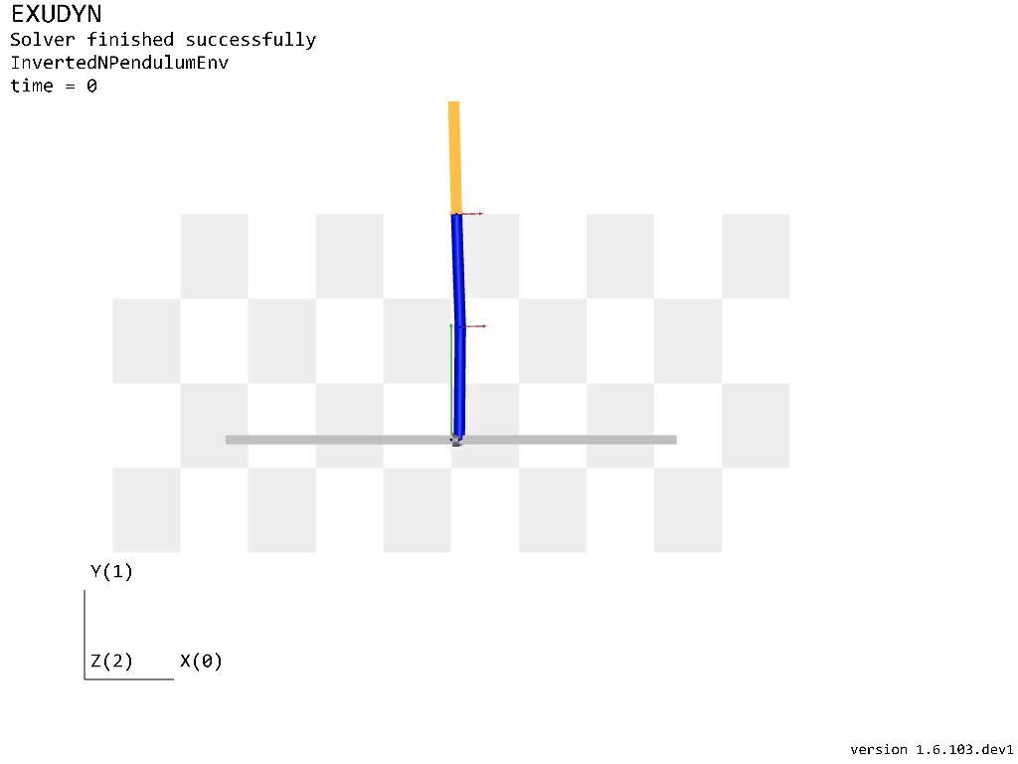
Triple Pendulum
PPO
79/100 tests achieved on 180k for case 1
(at least 300k needed for discrete control)
6

Slide 7
Outcomes
Comparing continuous control approach to a discrete one in the case of different pendulum systems, each being more complex than the previous one, results in a faster training and more smooth control
PPO, which was mainly analyzed, outperformed its discrete version in all of the 3 cases
A2C wasn’t properly working for the triple pendulum case, but it requires more investigation
Special algorithms, that were specifically created to handle continuous control space, such as SAC, DDPG or TD3 are very slow in training and require a very powerful hardware
Training of the system is very sensible to its parameters, especially to the reward function and to the interval of the applied cart force
7

Slide 8
Next steps
The first thing to do is to achieve comparable performance for A2C as well
Another thing is to make one of continuous control algorithms (SAC, DDPG, TD3) work
Most likely after accomplishing runs with another methods it is possible to do a proper comparison with the discrete control scheme
8

